Slide 1
Lab of Signals and Systems Introductions

Slide 2
Teaching Team
Name | Email | Tel | Name | Email | Tel
陆林燕 | luly@shanghaitech.edu.cn | 15618296017 | 王萍
张汉中 | zhanghzh@shanghaitech.edu.cn |  | 王誉洁 | wangyj5@shanghaitech.edu.cn
李睿嘉 | lirj1@shanghaitech.edu.cn |  | 杨蕾 | yanglei1@shanghaitech.edu.cn
徐佳飞 | xujf2@shanghaitech.edu.cn |  | 苏晏园 | suyy@shanghaitech.edu.cn
杜旭 | duxu@shanghaitech.edu.cn |  | 贺晓赫 | hexh@shanghaitech.edu.cn
袁善帅 | yuanshsh@shanghaitech.edu.cn |  | 郎浩然 | lanhr1@shanghaitech.edu.cn
苑子康 | yuanzk@shanghaitech.edu.cn |  | 侯佳维 | houjw@shanghaitech.edu.cn

Slide 3
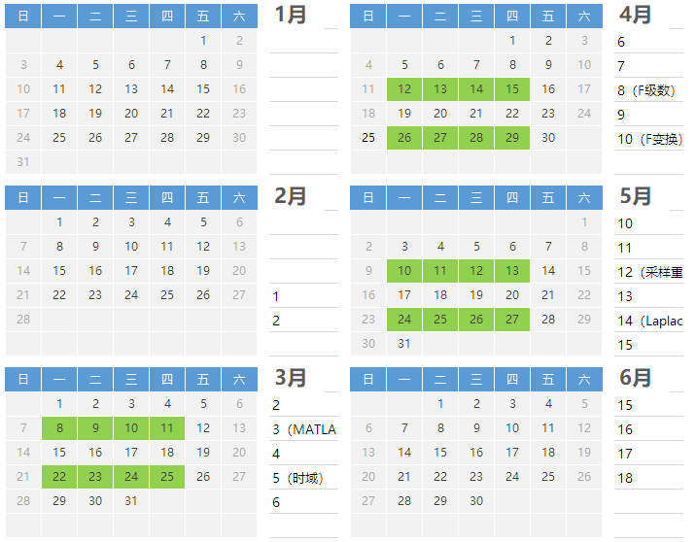
Time Table
Materials for preview released
Class time
Pre-lab/lab report submitted
Time to preview and finish the pre-lab report

Slide 4
About Class and Grading
6 labs is included in the course.
Every lab (except lab1) will have: pre-lab report and lab report.
The final score are composed of all the pre-lab reports and lab reports.
Lab 1 |  | Lab 2 |  | Lab 3 |  | Lab 4 |  | Lab 5 |  | Lab 6
0 | 10 | 4 | 14 | 4 | 14 | 4 | 14 | 4 | 14 | 4 | 14
Monday | Tuesday | Wednesday | Thursday
13:00-15:15(15:30) | 13:00-15:15(15:30) | 15:00-17:15(17:30) | 13:00-15:15(15:30)
Tips:
Please be sure to participate in each lab and submit the pre-lab reports and lab reports.
The pre-lab reports are required to be submitted at the beginning of the class and the lab reports before the end of the class.
If it is really impossible for you to attend the class, please contact Mrs. Lu for class adjustment in advance.

Slide 5
About report
Pre-lab report:
Pre-lab report should be finished independently. Every student is required to submit his/her own pre-lab report at the beginning of the class.
No code is required in the pre-lab report.
The use of the internet is permitted, but plagiarism is not allowed. Answer the question yourself.
Lab report:
Submit one copy for each group.
The scope of discussion is limited to the group. Please raise your hands for help from the teacher or TA instead of other groups.

Slide 6




诚信
花时间了，多少学点东西
至少本Lab的成绩取消，课程成绩可能取消
课程不难，预习+听课肯定没问题
课程档案中会留有记录
老师和助教们都很nice
抄袭者和被抄袭者同样处理，不接受说明
……

Slide 7

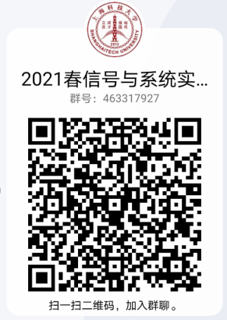
Interactive
2021 EE150L
信号与系统
实验课
463317927
课程通知、资料发布
作业发布、提交、评分
讨论答疑：论坛
通用问题交流
课程资料发布
沟通交流

